Slide 1


Fundamentals of RM
RM System and Process
Leadership in RM
Incident Investigation
RM Tools & Challenges
RM in Industry
People & Org.
Application and Perspectives
On Becoming a
Leader in Risk Management
ENGG404 - Lecture
Chapter 2.5:
What is an Acceptable
Level of Risk?

Slide 2
Learning Outcomes:
Interpret a set of risk criteria to determine a risk level.
Construct risk matrices for simple operations and systems, and evaluate the acceptance of risks through these matrices.
Apply a generic risk matrix to decide whether to accept the residual risk and manage it, or determine if additional control measures / safeguards are needed to reduce the risk to an acceptable level.
Chapter 2.5 What is an Acceptable Level of Risk?
2
Notes:
2

Slide 3
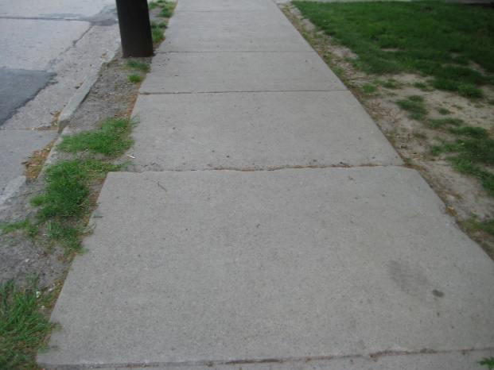
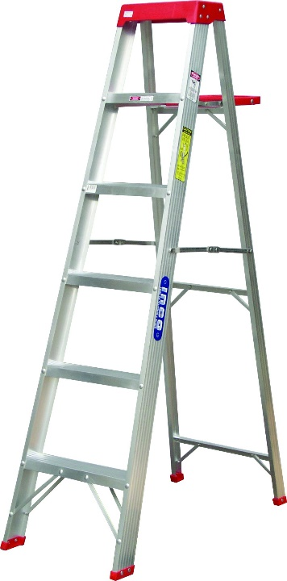
ALE #1: Every Activity Has Associated Risks:
Everything we do involves risk and the acceptance of some level of risk.
But there are different types of risk:
Consider walking on the sidewalk versus climbing a high ladder
Climbing a ladder is a high hazard activity, while walking on the sidewalk is not a high hazard activity.
Q: What about the risks of these two?
Please confer and respond:
If climbing a ladder is a high hazard activity, then it a high risk activity.
True or false? (Show of hands)
Why? (Open discussion)
Chapter 2.5 What is an Acceptable Level of Risk?
3
Notes:
3
Skydiving, Driving in a vehicle, Working at a plant, Pedestrian in the street - all voluntary individual
Public around a plant – involuntary societal
Annual probabilities of risk
1 in 100,000 as a pedestrian
1 in 10,000 working at a manufacturing plant
1 in 10 as an old person (dying in the next year)
Doesn’t determine when or where
What is the consequence? Death is the consequence
Less tolerance for involuntary risk than voluntary
Riding motorcycle – voluntary risk that may change with time

Slide 4
Acceptable Level of Risk:
TRUE or FALSE?
If climbing a ladder is a high hazard activity,
then it is a high risk activity.
False
  Even though climbing a ladder is a high hazard activity,
  it is not necessarily a high risk activity.
  High hazard potential does not equate to high risk.
Why? You can apply control measures to the high hazard activity
in order to reduce the risk to an acceptable level.
How? You can either:
              Reduce the likelihood or
              Reduce the consequence, or
              Reduce both,
              Reduce (control) or eliminate the hazard.
Chapter 2.5 What is an Acceptable Level of Risk?
4
Notes:
4
Just because an activity has significant hazards, does not mean that it is a high risk activity. You can implement measures to reduce risk to an acceptable level.

Slide 5
Build on Chapter 2:
Risk is a function of consequence and likelihood.
Thus, safeguards (control measures) can be implemented to:
reduce the consequence, or
reduce the likelihood, or
eliminate, reduce, or control the hazard.
Reduce the consequence
Reduce (control), or Eliminate the hazard
Reduce the likelihood
How bad
can it be?
What can
go wrong?
How likely
is it to occur?
Risk
Do NOT do
(or stop doing)
the activity.
NO
Is Risk Acceptable?
YES
Do
(or keep doing)
the activity.
Chapter 2.4 Risk as a Function of Likelihood and Consequence
5
Notes:
5

Slide 6
The Simple Risk Matrix:
Simple Risk Matrix:
Terms Used:
Simple = Fundamental
Consequence = Impact =
Severity
Likelihood =
Probability =
Frequency =
Rate
H
M
L
M | H | H
L | M | H
L | L | M
Increasing
Consequence
L M H
Increasing Likelihood
Chapter 2.5 What is an Acceptable Level of Risk?
6
Notes:
6
But how do we define L, M, H?

Slide 7
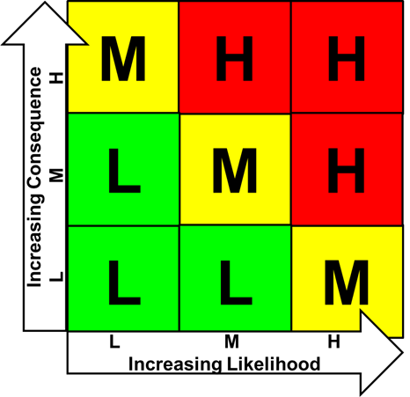
Risk Criteria Table:
L, M, H Consequence and L, M, H Likelihood
(This is relative and will change depending on the company.)
Ratings | Impact on PEAP (Consequences) | Likelihood
High | High P Disabling injury, loss of body part or fatality. E Reportable violation, toxic release. A High repair cost (Typically > $100k). Pr Loss of function of facility for extended period, with business consequences, major quality deviation. | High Repetitive event. At least once per year Several times in the life cycle of a project. Has happened frequently in similar circumstances. Greater than 50% chance of occurring.
Medium | Medium P Medical Aid injury. E Non-reportable spill, non toxic release. A Moderate repair cost (typically > $10k). Pr Short duration loss of function, serious quality deviation, medium business impact. | Medium Infrequent event. May only happen occasionally (less than once per year). Has been observed in similar circumstances. 10 to 50% chance of occurring.
Low | Low P First aid injury. E Minor lead, non toxic fugitive emission. A Low repair cost (typically <$10k). Pr Brief interruption or minor quality deviation or minor cost to correct. | Low Unlikely event. Never happened to date. Has never been observed but is still felt to be a possibility Less than 10% chance of occurring.
Chapter 2.5 What is an Acceptable Level of Risk?
7
Notes:
7

Slide 8

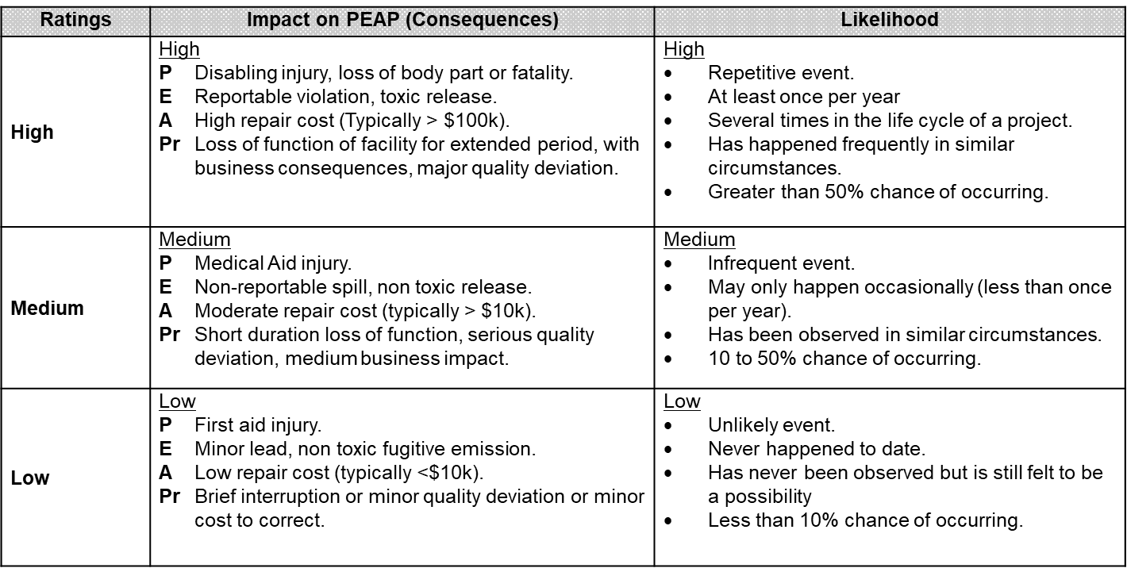
Risk Criteria Table:
L, M, H Consequence
Chapter 2.5 What is an Acceptable Level of Risk?
8
Notes:
8

Slide 9
Risk Criteria Table:
L, M, H Likelihood
Chapter 2.5 What is an Acceptable Level of Risk?
9
Notes:
9
An activity with a low Likelihood but a high impact on peap, then it results in a medium risk

Slide 10
Risk Matrix:
Simple Risk Matrix: relates to the Risk Criteria Table, and demonstrates the relationship that Risk is a function of Consequence x Likelihood,
and categorizes the risk level.
Chapter 2.5 What is an Acceptable Level of Risk?
10
Notes:
10
Risk level is based on the risk criteria.
Increasing likelihood increases the risk level.
Increasing consequence increases the risk level.
Risk is a function of likelihood and consequence, and there is a level of risk which is defined as “Low”, “Medium”, or “High”. But these do not yet define what is an acceptable level of risk.

Slide 11
Risk Matrix:
What does Risk Management Direction Mean?
For any given level of risk for an activity, there must be a decision about the activity based on its risk level (i.e. to proceed or not to proceed).
Risk Management Directions:
High means “do not proceed”.
Medium means “do not proceed until further protective measures are applied”.
Low means “proceed with caution”
If deemed too high, management direction will dictate how to reduce risks (likelihood and consequence) for a given activity.
Chapter 2.5 What is an Acceptable Level of Risk?
11
Notes:
11
Management directions go along with each level.
The decision as to whether the risk level of an activity is acceptable or not, is defined by the management directions for that level of risk.
How can you reduce the risks to an acceptable level?

Slide 12
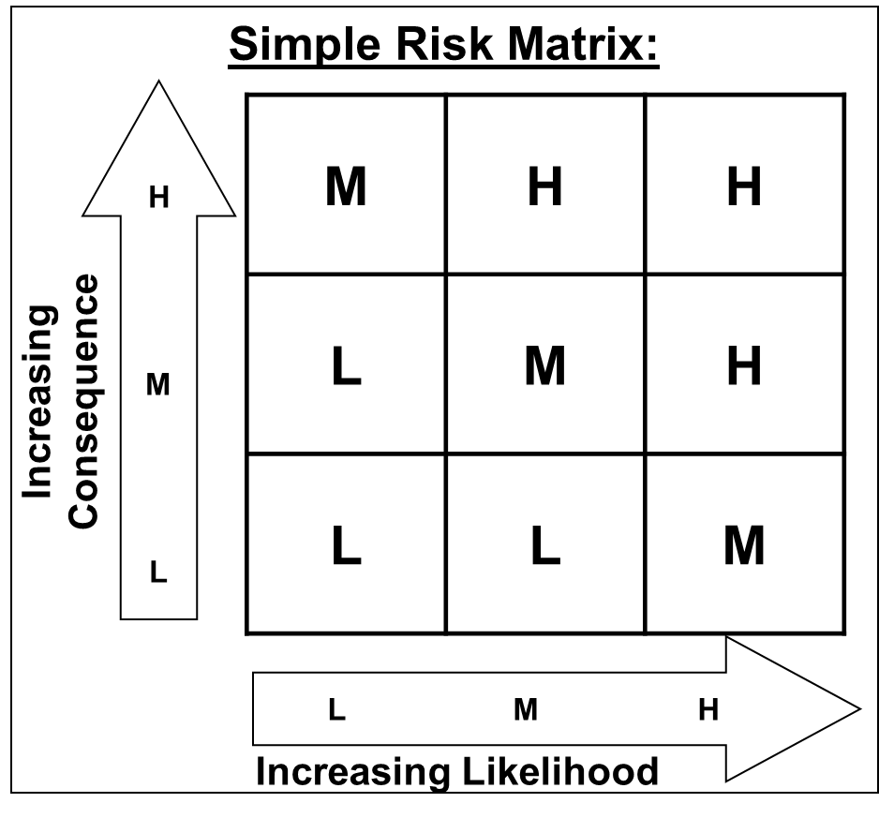
Management Direction:
Up to interpretation; depends on risk tolerance of the organization.
Every organization will have a set of Management Directions.
You will need to explain and apply for your future organization!
“Organization A” “Organization “B”
High means do not proceed; take action to reduce risk if possible.
High means do not proceed.
Medium means proceed with caution (ensure safeguards are adequate and implemented)
Medium means do not proceed until additional control measures are implemented.
Low means readily proceed
Low means proceed with caution
Chapter 2.5 What is an Acceptable Level of Risk?
12
Notes:
12
Up to some interpretation
Different risk profiles
Mgmt directions may be expressed differently from company to company
But all reduce the risk to an acceptable level in order to proceed

Slide 13
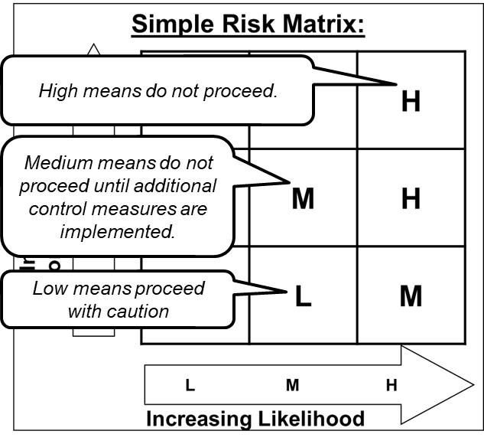
ALE #2: Apply Risk Management Direction
Please confer:
Transfer of liquefied propane gas through a flexible transfer hose from storage tank to truck (an acceptable transfer).
Using Risk Criteria table:
Impact/Consequence: “could result in a disabling injury or fatality, a toxic release, etc.”, and
Likelihood: “has been observed in similar circumstances”
Please confer and select from the Risk Table and Matrix (MM-Poll):
Consequence = __________ Likelihood = __________
What is the risk level? What should management do in this situation?
Chapter 2.5 What is an Acceptable Level of Risk?
13
Notes:
13
LEAVE UP WHILE STUDENTS CONFER

Slide 14
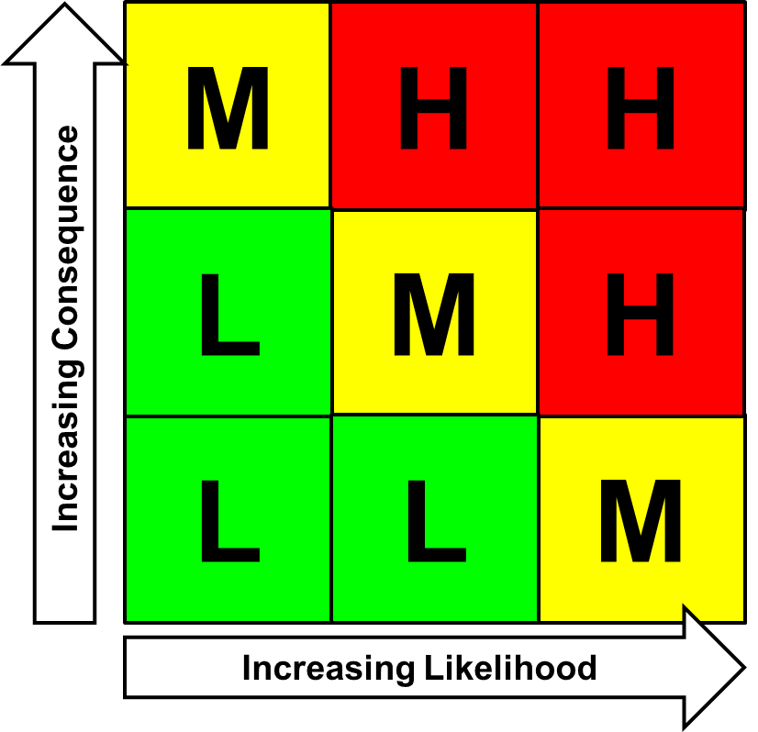
Example: Apply Risk Management Direction
What is Our Decision?
Scenario: of liquefied propane gas through a flexible transfer hose from storage tank to truck (an acceptable transfer).
Using Risk Criteria table: “has been observed in similar circumstances”, and “could result in a
disabling injury or fatality,
a toxic/flammable release, etc.”
From the table:
Consequence = High,
Likelihood = Medium
Therefore ….
Risk is “High”
And
“Do NOT Proceed”
Do Not Proceed
Chapter 2.5 What is an Acceptable Level of Risk?
14
Notes:
14

Slide 15
Example: Apply Risk Management Direction
What Does This Mean about Our Business Activity?
We are in the business of storing, transferring, and shipping LPG, so …. do all LPG transfers need to cease?
What needs to happen in order
for the activity to proceed?
We simply cannot shut
down our business, right?
What should we do?
Do Not Proceed
Chapter 2.5 What is an Acceptable Level of Risk?
15
Notes:
15

Slide 16
Example: Apply Risk Management Direction
What should we do?
What should the management direction be?
How do you reduce the risk to an acceptable level?
How do you decrease the likelihood and/or
consequence of an activity?
So you have reduced the risk:
Now what?
“Residual Risk” is the (acceptable)
level of risk ‘left over’ after
controls have been put in place.
Needs to be managed on
an ongoing basis.
OK to Proceed
Chapter 2.5 What is an Acceptable Level of Risk?
16
Notes:
16

Slide 17
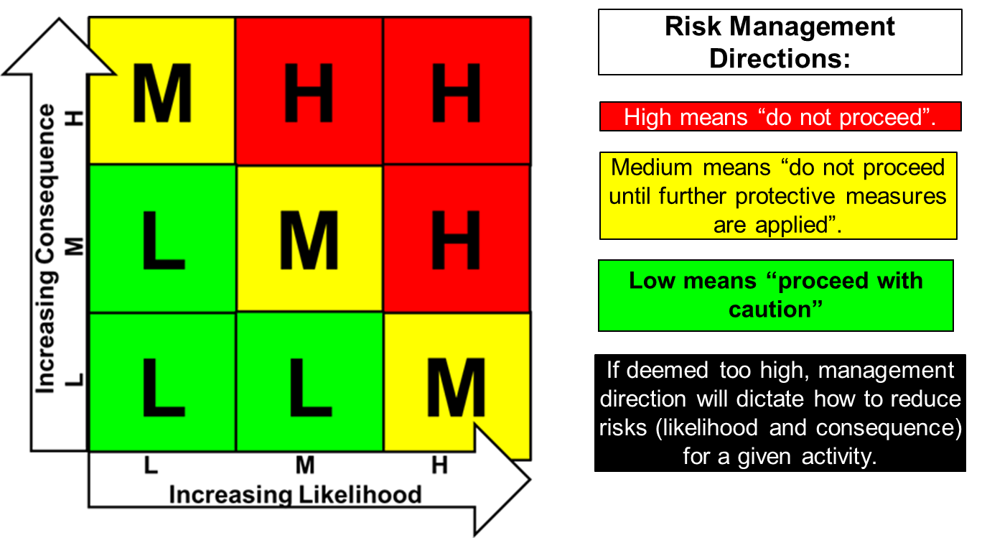
Summary and Key Lessons:
We evaluate risk to reduce PEAP losses and increase profitability
We use tools such as risk matrices and risk criteria tables to assess the level of risk from an activity.
If deemed too high, management
direction will dictate how to reduce
risks (hazard, likelihood, consequence)
for a given activity to a level acceptable
to the organization, or discontinue the
activity if not acceptable.
The level of risk after control measures have been applied to reduce the risk to an acceptable level is termed the “residual risk”.
Chapter 2.5 What is an Acceptable Level of Risk?
17
Notes:
17

Slide 18
Any questions?
Notes:
18

